Slide 1
River Water Parameters Analysis
An overview of water quality measurements at various sampling points

Slide 2
What will we learn in this lesson?
Introduction: Overview of the project and its objectives in analysing river water quality.
Data Overview: Summary of dataset structure and cleaning steps.
Descriptive Statistics: Key statistical insights into water quality parameters.
Sampling Distribution: Visualization of sample counts.
pH and DO Trends: Time-based analysis of pH and dissolved oxygen levels.
Turbidity & Hardness: Comparison of turbidity and hardness across sampling points.
Conclusion: Final insights and recommendations for further monitoring.

Slide 3
Introduction
Objectives Supported by Data
Monitor Water Quality Across Locations
Sample counts and parameter variability show consistent monitoring across all five locations.
Assess Environmental Impact
Turbidity ranges from 1.06 to 1000 NTU, indicating significant variation in water clarity.
DO levels range from 0.00 to 9.12 mg/L, showing differences in oxygenation, crucial for aquatic ecosystems.
Identify Pollution or Anomalies
Hardness varies from 86 to 316 mg CaCO₃/L, suggesting mineral-rich zones.
Chloride levels range from 15 to 174 mg/L, with higher values potentially linked to urban or industrial runoff.
Track Temporal Trends
Data spans from May to October 2023, enabling seasonal analysis.
Project Overview Evidence
The dataset includes comprehensive measurements across multiple sampling points and dates, specifically:
Sampling Points:
Arroyo Salguero
Arroyo Las Torres
Puente Bilbao
Puente Falbo
Puente Irigoyen
Parameters Measured:
pH: Indicates water acidity/alkalinity
DO (Dissolved Oxygen): Vital for aquatic life
Turbidity: Reflects water clarity and potential pollution
Hardness: Measures mineral content (e.g., calcium carbonate)
Chloride: Indicates salinity and possible contamination

Slide 4

Data Overview
Data Cleaning Steps
Column Name Standardization:
Removed special characters (e.g., °, µ, /).
Replaced spaces and newlines with underscores.
Ensured consistent naming for easier access and analysis.
Date Formatting:
Converted Date (DD/MM/YYYY) to proper datetime format.
Enabled time-series analysis and seasonal trend detection.
Missing Value Handling:
Identified missing entries:
TSS (mL sed/L): 6 missing
Level (cm): 39 missing
Turbidity (NTU): 1 missing
Hardness (mg CaCO3/L): 2 missing
Hardness classification: 2 missing
Total Cl- (mg Cl-/L): 6 missing
These gaps were noted for consideration in analysis and visualization.

Slide 5
Descriptive Statistics
Parameter | Count | Mean | Std Dev | Min | 25% | 50% | 75% | Max
pH | 212 | 8.05 | 0.26 | 7.30 | 7.90 | 8.10 | 8.20 | 8.70
DO (mg/L) | 212 | 2.67 | 1.95 | 0.00 | 1.25 | 1.89 | 4.02 | 9.12
Turbidity (NTU) | 212 | 126.84 | 204.62 | 1.06 | 26.35 | 56.65 | 127.25 | 1000.0
Hardness (mg CaCO₃/L) | 212 | 191.23 | 56.48 | 86.00 | 146.00 | 188.00 | 228.00 | 316.00
Chloride (mg Cl⁻/L) | 212 | 102.38 | 32.66 | 15.00 | 71.00 | 109.00 | 124.25 | 174.00

Slide 6
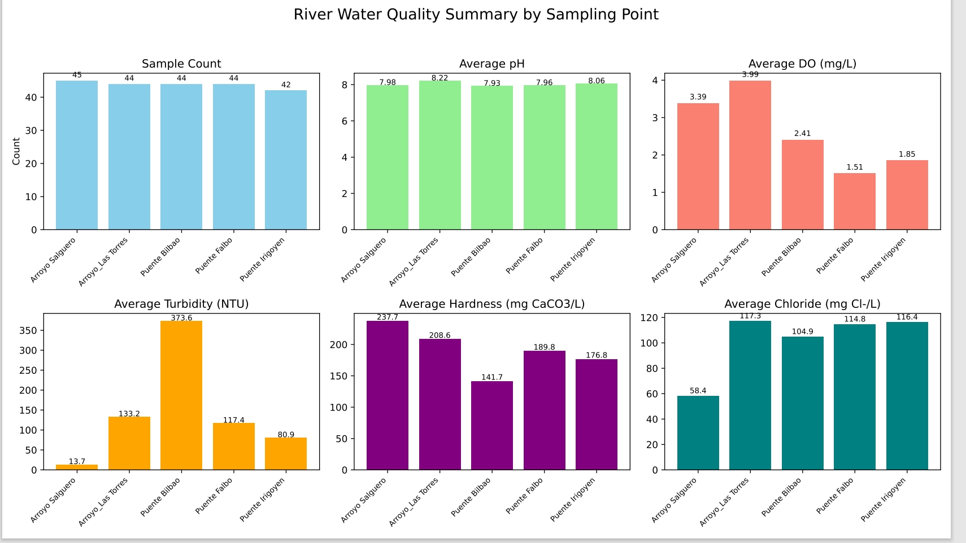

Slide 7
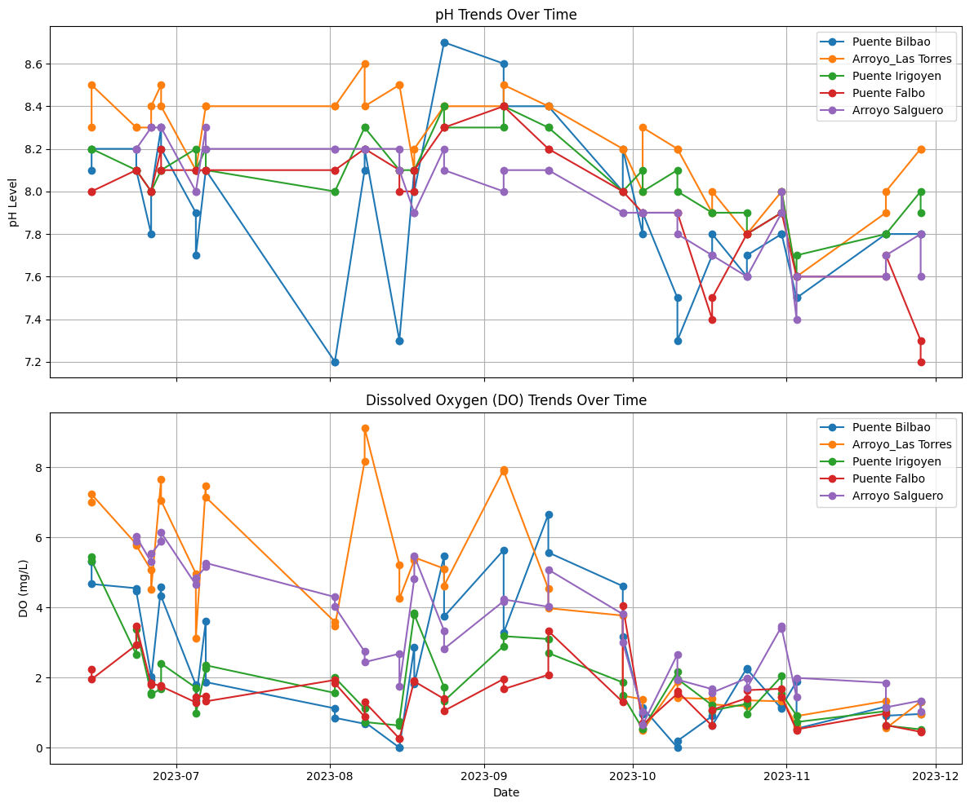

Slide 8
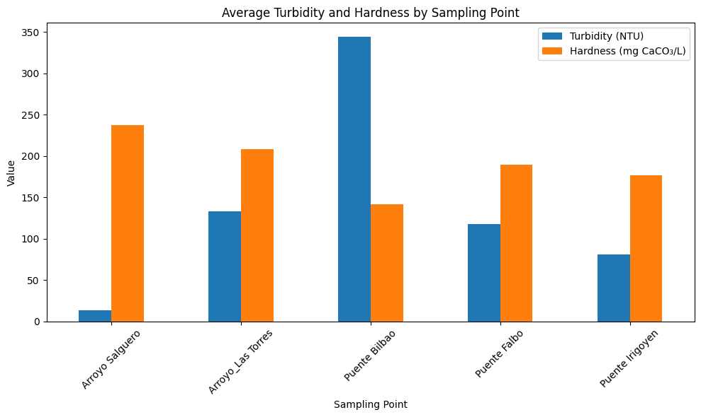

Slide 9

Every number tells a story

Slide 10
Conclusion
Recommendations for Further Monitoring
Target High-Risk Areas:
Investigate high turbidity at Puente Bilbao and low DO at Arroyo Salguero.
Track Seasonal Trends:
Continue monitoring pH and DO over time to detect environmental or anthropogenic changes.
Investigate Mineral Content:
Explore causes of high hardness and chloride at Arroyo Las Torres and Arroyo Salguero.
Ensure Sampling Consistency:
Maintain balanced and regular sampling across all locations for reliable trend analysis.
Expand Parameter Scope:
Include EC (Electrical Conductivity) and TDS (Total Dissolved Solids) in future assessments for a more holistic view of water quality.
Final Insights
pH:
Highest average: Arroyo Las Torres (8.22)
Lowest average: Arroyo Salguero (7.98)
Dissolved Oxygen (DO):
Highest average: Arroyo Las Torres (3.99 mg/L)
Lowest average: Puente Falbo (1.56 mg/L)
Turbidity:
Highest average: Puente Bilbao (310.95 NTU)
Lowest average: Arroyo Salguero (13.68 NTU)
Hardness:
Highest average: Arroyo Salguero (237.67 mg CaCO₃/L)
Lowest average: Puente Bilbao (141.25 mg CaCO₃/L)
Chloride:
Highest average: Arroyo Las Torres (117.34 mg Cl⁻/L)
Lowest average: Arroyo Salguero (58.38 mg Cl⁻/L)

Slide 11
Thanks!

